Slide 1
ACME Inc.

Slide 2
Dell Boomi Integration Solution
Value Propositions, Capabilities & PoCs
Monday, July 29, 2019

Slide 3
1. Integration Opportunity 2. Problem Statement 3. Boomi Value Proposition 4. Boomi Capabilities 5. Proof of Concepts
Overview

Slide 4
ACME Inc.
Integration Opportunity
ACME Inc. has a legacy MySQL based ERP which manages the customers.
ACME has recently adopted SFDC as CRM, and would like it to co-exist with the current ERP.
Notes:
Speaker Notes:
About ACME Inc.
Explain about the customer Integration problem, refer the word doc.

Slide 5
ACME Inc.
Problem Statement
An enterprise integration platform that serves as standard for all integrations
The ability to handle all Cloud, On Premise, and Hybrid applications seamlessly
Single interface for Integration flow design and management, administration and monitoring
Easy to learn and maintain
Support for a variety of connectivity protocols and data/message delivery styles
Supports real time Integrations with little overhead
A scalable Cloud Platform
A Cost effective solution
Notes:
Speaker Notes:
ACME Inc. Problem Statement
Validate the problem statement with the customer, confirm if the PS is correct?
Prioritize the issues/areas, if required

Slide 6
Boomi Value Proposition
Drive ACME Inc. Business Forward
Reduce TCOs, TTM, CAPEX, OPEX
Increase SLAs, Customer Satisfaction, etc.
Connect Everything
Engage
Everywhere
Run
Anywhere
Notes:
Speaker Notes:
Highlight this talks about one of the value proposition – Drive Your Business Forward
Achieved thru Design Thinking and Persona based Omni-Channel integration Approaches

Slide 7
Boomi Value Proposition
Highlights
Unified Platform
Our intelligent, flexible, and scalable integration platform accelerates your business by making information, interactions and innovations flow faster
More than 8,000 of the world’s leading brands to quickly and easily unite your digital ecosystem
The Unified Platform: End-to-end capabilities including application/data integration, API management, data quality governance, B2B network management, low-code workflow automation and application development
Accelerate Your Business Outcomes - all in one platform
Connect - Unify data, applications, processes and people – Connect existing IT systems and assets
Modernize - Build new capabilities for the future – Modernize your technology infrastructure, eliminate old, brittle technology
Transform - Reinvent the way you work – Transform your workflows and processes
Innovate - Imagine entirely new ways of serving customers – drive innovation on new products, experiences, and business models
Notes:
Speaker Notes:
Highlight this talks about one of the value proposition – Drive Your Business Forward

Slide 8
Boomi Value Proposition
Business Benefits
Analyst Reports
Speed projects by up to 1000%
Reduce costs by up to 50%
Achieve ROI of up to 300%
Shortening development timelines by 70%
More from the Analyst Firm Reports!
Read Industry Leading Analyst Firm Reports
Forrestor - https://boomi.com/wp-content/uploads/the-total-economic-impact-of-the-dell-boomi-platform.pdf
Ovum – https://boomi.com/wp-content/uploads/The-Value-Proposition-of-Dell-Boomi-iPaas-Ovum.p
Notes:
Speaker Notes:
In Summary, Boomi is:
Platform: Platform, Integrate, Hub, Exchange, Mediate, Flow
Solutions: Connect, Modernize, Transform, Innovate
Services: Training & Certifications, Support, Professional Services, Customer Success
Others: Customers, Partners, Resources

Slide 9
Boomi Capabilities
Elements of the Boomi Platform
B2B/EDI
Management
Master
Data Hub
Hub
Exchange
Integrate
Application and
Data Integration
Flow
Mediate
API Design and
Management
Workflow Automation
and App Development
Notes:
Speaker Notes:
Platform capabilities work around Integration

Slide 10
Boomi Capabilities
Dell Boomi Platform Components
Integration
Dashboard, Build, Manage, Deploy all in one place
Online, Desktop accesses
Platform capabilities work around Integration
Flow
Modern, Cloud-Native, Rich and Realtime UI widgets and interfaces
Workflow automation and app development enable you to build customer journeys with low-code development
Draw, Publish, Engage!
Notes:
Speaker Notes:
Two major focus tools are:
Integration
Signup for Twilio tenants using corporate credentials
Setup Org and Account structure
Setup Security Key and configure with Password i.e. Password+Security Token
AtomSphere, Atom, Molecule, Atom Cloud provides the Integration richness!
Runs on sophisticated Atom/Molecule engines
Provides all major industry leading Connectors and Shapes for the processes
Flow
Requires a separate setup and signup
Explain RWD, RIA, Web 2.0, Lowcode concepts

Slide 11
Proof of Concepts
Criteria
Entry Criteria
Problem statement, use cases, and solution options analyzed & understood
Define PoC Approach
Successfully set-up the following accounts:
Dell Boomi Integration
Dell Boomi Flow
Salesforce Sales Cloud
MySQL/SQL server
Twilio
Exit/Success Criteria
Connected to platforms on the left via. Dell Boomi Integration and Flow
Seamless, cost effective and real-time Integration platform solution based on Cloud, On Premise, and Hybrid applications
Adopt Salesforce for prospecting
Capturing Prospect to Customer journey in MySQL & visualize them in Twilio
Notes:
Speaker Notes:
Entry Criteria
These are the set of entry criteria and in our parameters that we understood, please validate
PoC Approaches
Bottom Up Approach
Setup Connectors (Salesforce, MySQL, Twilio) first
Top Down Approach
Start Boomi Integration and Flow first
Hybrid Approach
Perform tasks as become available
Exit/Success Criteria
These are the set of entry criteria and in our parameters that we understood, please validate
The above are the expected outcome from the PoC exercise

Slide 12
Proof of Concepts
Dell Boomi Integration Capabilities Solution Demo
Build a process from SFDC to MySQL
Build a process from MySQL to SFDC
Boomi Flow with Twilio Integration
Notes:
Speaker Notes:
Solution Demo
I’m going to demonstrate 3 use cases to highlight Dell Boomi’s capabilities
Dell Boomi can connect and process much more than the samples above
Network Settings
Options:
a) Godaddy MySQL with fixed IP to avoid “Use Boomi Atom” whitelisting
Godaddy MySQL needs IP whitelisting if you need to use“SE Env”
b) Any other Cloud provider (Azure/AWS IaaS/DBaaS)
c) Localhost
Configure your Wireless Router for Port Forwarding for local installs
Configure list of IP Addresses found under https://help.boomi.com/bundle/integration/page/r-boo-Hostnames_and_IP_addresses_for_platform_a5f68e32-b852-4e36-bdee-80423232a17a.html to allow incoming traffic
Understand if you connected to Corporate Network, VPN, or Home Wireless and configure Ports, Firewalls, on Router accordingly (ping, tracert IP addresses to verify)
Router/Linksys – Port 3306 is opened via Dashboard with login credentials, try to bypass the Modem to check if the Port is opened on the end of Model, Port is closed
ISP/Xfinity – performs open Ports from ISP/Model. Port opened from Router as above, if Port for MySQL is closed..
Modem/Aris –
Repeat the same for http/80, https/443, ftp/23 Ports, if required

Slide 13
Proof of Concepts
Cheat Sheet for Bottom Up Approach
Salesforce
Acquire Salesforce license and credentials
Setup Account
MySQL
Design Schema for the PoC usecases
Decide MySQL options
A) Download and install
local MySQL
B) Provision MySQL in
the Cloud
Notes:
Speaker Notes:
Salesforce
Signup for Salesforce (Trials and Developer Accounts) tenant using corporate credentials – M*******.*@***.com S***********5
Setup Org and Account structure – Create few Account with Type Prospect and others
Generate/Setup Security Token and configure with Password i.e. Password+Security Token using the url https://na112.lightning.force.com/lightning/settings/personal/ResetApiToken/home
Credentials mansoor@force.com S*******5 8SLfL8gpVIeorUBO9sU4G7cUb
Refer https://boomi.com/wp-content/uploads/The-Ultimate-Salesforce-Integration-Guide.pdf
Exceptions Faced
A) Salesforce Import Wizard
Error attempting to browse Salesforce operations. Error executing login. Error message received from Webservice. ERROR: sf:API_DISABLED_FOR_ORG --------------- API_DISABLED_FOR_ORG: API is not enabled for this Organization or Partner
Resolution: You have to sign up for a Developer account. That will be a different Username than your trial user account. https://developer.salesforce.com/
B) Test
Atom Setup: The action that you are attempting to complete requires that at least one Atom is installed. Would you like to install an Atom? Can’t do without Administrator access to the laptop.
MySQL
1) Schema & Table
Prepare table design and schema (boomisales.customer) and keep them handy
CREATE TABLE IF NOT EXISTS customer (Id INT AUTO_INCREMENT, Name VARCHAR(255) NOT NULL, Type VARCHAR(255) NOT NULL, PRIMARY KEY (Id))
2) Connection Options:
a) Godaddy MySQL or Other Public Cloud such as AWS, Azure /IaaS/PaaS/DBaaS with fixed IP to avoid “Use Boomi Atom” whitelisting
Godaddy Host 198.71.225.50 (or 160.153.71.135) Port 3306 Username mansoor Password W*********@M Database sales Table customer
Use cPanel or phpMyAdmin or Chrome MySQL Plugin Editor to connect and/or query the database
b) Localhost
Configure your Wireless Router for Port Forwarding for local installs
Configure list of IP Addresses found under https://help.boomi.com/bundle/integration/page/r-boo-Hostnames_and_IP_addresses_for_platform_a5f68e32-b852-4e36-bdee-80423232a17a.html to allow incoming traffic
Understand if you connected to Corporate Network, VPN, or Home Wireless and configure Ports, Firewalls, on Router accordingly (ping, tracert IP addresses to verify)
Router/Linksys – Port 3306 is opened via Dashboard with login credentials, try to bypass the Modem to check if the Port is opened on the end of Model, Port is closed
ISP/Xfinity – performs open Ports from ISP/Model. Port opened from Router as above, if Port for MySQL is closed..
Modem/Aris –
Repeat the same for http/80, https/443, ftp/23 Ports, if required

Slide 14
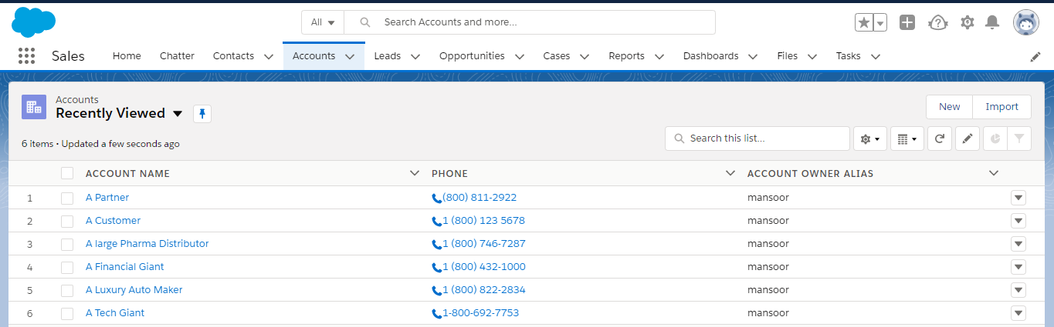
Proof of Concepts
Accounts in Salesforce
Notes:
Speaker Notes:
Salesforce
4 Prospects
1 Customer
1 Partner

Slide 15
Proof of Concepts
Cheat Sheet for Bottom Up Approach
Dell Boomi
Decide Runtime Environment to test connection (Atom vs Use Boomi Cloud)
Provision the following:
A) Salesforce
B) MySQL
C) Twilio
D) Dell Boomi Flow
Twilio
Text Messages and Other Communications
Integrates with Boomi
Notes:
Speaker Notes:
Dell Boomi
Signup for Boomi tenants using corporate credentials Mansoor@SeniorArchitects.com D********5
Setup Atom Environment for Runtime and Testing
Manage->Atom Management->Environment (ACME Inc. Onprem PoC Env)
Create Atom (Atom Installer Token atom-f0bb64e5-d681-4a21-b39f-99311d744da1) – this need Administrator access in your PC/Laptop
Integration Components to be used: A) Salesforce B) Flow Control C) Map D) MySQL E) End
Flow.manywho.com with credentials Mansoor@SeniorArchitects.com D*********5
Twilio
Signup for Twilio tenants using corporate credentials
M*******.*@***.com T********53***5 Account SID ACbbee1852da32753fabb684d1008e2ffe Auth Token d9cdc22498a6571c96928ffe13f8d38c (check) or
M******@*************.com T********53***5 Account SID ACbbee1852da32753fabb684d1008e2ffe Auth Token d9cdc22498a6571c96928ffe13f8d38c
Setup Org and Account structure
Setup Security Key and configure with Password i.e. Password+Security Token

Slide 16
Proof of Concepts
Build a process from SFDC to MySQL
Find all accounts of type prospect, which have been modified in the past 24hrs
If it does not exist, transform the customer data into the format of the MySQL DB
As a part of the transformation, create a unique identifier other than SFDC_ID that will be used as a
primary key in the MySQL DB
Insert into MySQL DB
Notes:
Speaker Notes:
Use Case 1 – Salesforce to MySQL
Enables new Cloud based Salesforce into ERP ecosystem

Slide 17
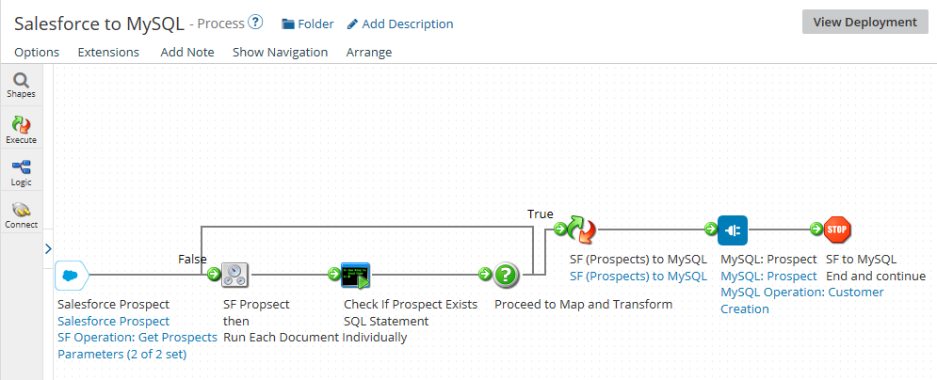
Proof of Concepts
PoC process from SFDC to MySQL
Connectors (Salesforce, Database) & Shapes (Flow Control, Map, Stop)
Notes:
Speaker Notes:
PoC#1 – Salesforce to MySQL
Walk through the Process, Connectors, Shapes
Demonstrate from Salesforce, Boomi Integration & MySQL
Dell Boomi
Signup for Boomi tenants using credentials
Setup Atom Environment for Runtime and Testing
A) Salesforce
Understand Org and Account structures
Get ready with Security Key to configure as Password i.e. Password+Security Token
Create Process named Salesforce to MySQL (Salesforce Prospect)
Create or select existing Connection named Salesforce Prospect
Create Operation named SF Operation: Get Prospects
Setup Salesforce Operation (Import Query Response, Add Filter & Expression, Runtime Parameter)
Import the Account Query object from Salesforce
Note down the Response Profile “SF_Account_QUERY_Response”
Setup Filters Type Equal To AND LastModifiedDate Greater Than
Configure Parameters from the Salesforce Prospect Start Process
For Type add Prospect as Static Value
For LastModifiedDate choose Type as Date/Time, Date Mask same as one found in the Account LastModifiedDate (yyyy-MM-dd'T'HH:mm:ss.SSS'Z'), Date Type as Relative Date, Relative To Current Date (-24 hours for the past 24 hours Prospect)
Run the Process under Atom Environment
Make sure the Prospects are retuned Documents as XML type setup in the “SF_Account_QUERY_Response” XML Profile
Connect to the below Flow Control
B) Program Control
Find if there’s any Prospect in customer table
C) Decision
D) Flow Control
Search Flow Control from Execute Shapes area
Select “Run Each Document Individually” and
Connect to the below Map
E) Map
Create Map Shape (SF (Prospects) to MySQL as Display Name)
Create Map (SF (Prospects) to MySQL as Map Name)
Map Source: Choose XML as Profile Type, Select Profile: SF_Account_QUERY_Response from ACME Inc project folder (you can optimize to only required fields later)
Map Destination: Choose Database as Profile Type, Select Profile: MySQL Profile: Prospects. Expand the Fields, start mapping from Source fields to Destination
Map Functions: User Defined Function, Create New Function (Create CustID)
Steps:
1. Create CustID value: Category: Lookup, Functions: Sql Lookup, Choose Connection, Enter Sql to Execute (make sure works in MySQL per requirement), Output: Name: Id to store the output of the above query, Type: Integer
2. Increment CustID value by 1: Category: Numeric, Functions: Math Add, Value: Id, Value to Add: 1
Map Id of Sql lookup to Math Add Value(Id)
Outputs
Map Fucntion Create CustID/Id to MySQL Profile: Prospects Id
Inputs – Not required, since deriving from Sql lookup
Connect this Map to MySQL
F) MySQL
Search Database from Execute Shapes area
Create or select existing Connection named Database Connection (MySQL: Prospect) with details found in MySQL section
Plan Database Operation (MySQL Operation: Customer Creation)
Plan Database Action as Send since we’re inserting record in MySQL
Setup MySQL Profile (MySQL Profile: Prospects)
Change Type to Dynamic Insert
Import Fields from sales.customer table using Database Import Wizard, click Next & Finish
Choose Columns from the customer table and Finish
G) Stop
Search Database from Execute Shapes area
Exceptions:
Test execution of Salesforce to MySQL completed with errors. Embedded message: There was an error executing the most recent statement; Caused by: Duplicate entry '2' for key 'PRIMARY’

Slide 18
Proof of Concepts
Build a process from MySQL to SFDC
Add 2 columns to your MySQL ‘customer’ table – ‘won’ and ‘notified’
Create a process that finds all won but not notified customers
Update the SF record for each customer returned from ‘Prospect’ to ‘Customer – Direct’
Update the DB column notified to 1 (indicating notified)
Send an email to yourself indicating that you have won the customer business.
Notes:
Speaker Notes:
Use Case 1 – Salesforce to MySQL
Enables new Cloud based Salesforce into ERP ecosystem
ALTER TABLE using
ALTER TABLE customer ADD COLUMN Won SMALLINT(1) AFTER Name, ADD COLUMN `Notified` SMALLINT(1) AFTER Won;
Create Find All Won Not Notified Customers Process with SELECT id, name, type FROM customer WHERE Won=1 AND Notified != 1

Slide 19
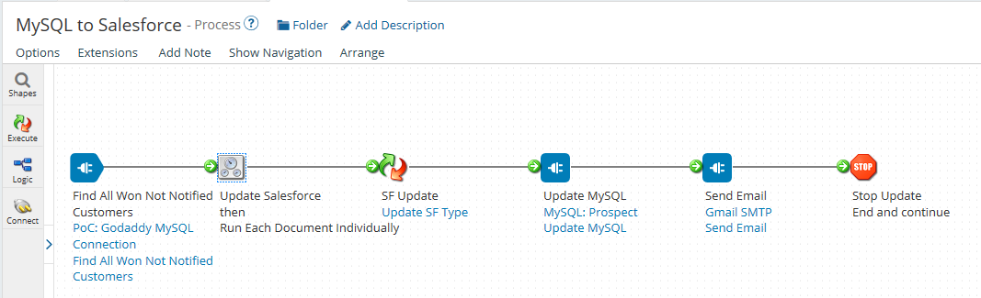
Proof of Concepts
PoC process from MySQL to Salesforce
Connectors (Salesforce, Database) & Shapes (Flow Control, Map, Stop)
Notes:
Speaker Notes:
PoC#1 – Salesforce to MySQL
Walk through the Process, Connectors, Shapes
Demonstrate from MySQL, Boomi Integration & Salesforce
Dell Boomi
Signup for Boomi tenants using credentials
Setup Atom Environment for Runtime and Testing
A) MySQL: Find All Won Not Notified Customers
Search Database from Execute Shapes area
Create or select existing Connection named Database Connection (MySQL: Prospect) with details found in MySQL section
Plan Database Operation (MySQL Operation: Customer Creation)
Plan Database Action as Send since we’re inserting record in MySQL
Setup MySQL Profile (MySQL Profile: Prospects)
Change Type to Dynamic Insert
Import Fields from sales.customer table using Database Import Wizard, click Next & Finish
Choose Columns from the customer table and Finish
B) Flow Control
Search Flow Control from Execute Shapes area
Select “Run Each Document Individually” and
Connect to the below Map
C) Map
Create Map Shape (SF Update as Display Name)
Create Map (Update SF Type as Map Name)
Connect this Map to MySQL
D) Salesforce: Prospect Update
Search Database from Execute Shapes area
Create or select existing Connection named Database Connection (MySQL: Prospect) with details found in MySQL section
Plan Database Operation (Salesforce Operation: Prospect Update)
Plan Salesforce Action as Send since we’re updating record in Salesforce
Setup Profile (Update Profile)
Change Type to Dynamic Update
Import Fields from Account using Salesforce Import Wizard, click Next & Finish
Choose Columns from the customer table and Finish
E) Send Email
Use Mail Shape
Use SMTP details from Gmail
F) Stop
Search Database from Execute Shapes area

Slide 20
Proof of Concepts
Boomi Flow with Twilio Integration
Use Boomi Flow to create an app that serves as a front-end UI for a sales rep. There is no need to incorporate AtomSphere
The app should allow a user to enter an Account name and select an Account record from SFDC
Hint: a searchable table component would be useful here
Once an Account has been selected, a text message should be sent via Twilio to a manager for approval for the sales rep to view details of the Account
Upon approval, the app should display field details about the Account (limit to any 5 fields)
Customize the app (players and assets) to include a company logo, colors and any other creative touches
Notes:
Speaker Notes:
Use Case 3 – Boomi Flow with Twilio Integration
Enables new Cloud based Salesforce into ERP ecosystem

Slide 21
Proof of Concepts
PoC Boomi Flow with Twilio Integration
Notes:
Speaker Notes:
PoC – Boomi Flow with Twilio Integration
Walk through the process

Slide 22
Thank You!
Questions?

